Slide 1
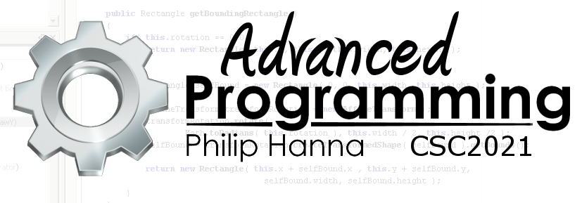
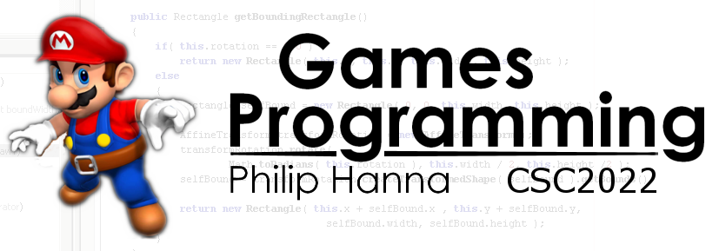
AI Controlled Jumping
Enabling AI agents to safely jump

Slide 2

Jumping

Slide 3

Steering behaviours typically re-evaluate decisions several times/second, correcting small mistakes. A jump action is a one-time, single event, fail-sensitive decision. It is inherently risky (i.e. it can fail, possibly with a ‘fatal’ outcome).
To jump, the character must be moving at the right speed and in the right direction and ensure the jump is executed at the right time.

Slide 4


: Jump Points
The most simple approach is to place jump points into the game level.
If characters can move with different speeds, then the jump point also needs a minimum jump speed.
The character can then seek towards the jump pad, matching the specified speed, and jump whenever it is on the jump pad.
Minimum jump velocity

Slide 5
: Difficulties
Some forms of jump require a defined target speed or a defined direction / angle of approach to the jump pad.
Additionally, some jumps may have a higher ‘price’ of failure (e.g. ‘death’ vs. a short delay to climb-up).
Precise jump speed needed
Precise jump direction needed

Slide 6
: Landing Pads
A good approach is to pair a jump pad with a landing pad.
Doing this permits the game object to determine the needed speed and direction (by solving the trajectory equations).
This approach is more flexible (different characters can differ in their movement approach) and is less prone to error.

Slide 7

Key takeaways:
By pairing a jump pad with a landing pad it becomes possible to enable AI controlled entities to plan and safely execute jumps.

